Slide 1

Analysis on query management
Eleanor Tay

Slide 2
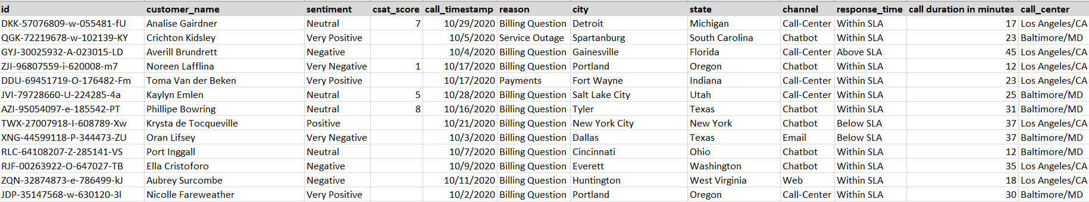




Snippet of database – call center records

Slide 3


Tools used
Original data in csv file
Imported csv file into HeidiSQL and performed queries in SQL
Data exploration and cleaning
- Changed call_timestamp from Varchar format to sql standard date format using str_to_date function
Changed csat_score with 0 values to null
Changed 5 levels sentiment to 3 levels of sentiment for simplicity
‘Very negative’ and ‘negative’ sentiments -> negative sentiment
‘Very positive’ and ‘positive’ sentiments -> positive sentiment
Statistics of the cleaned data
32,941 rows, 12 columns

Slide 4
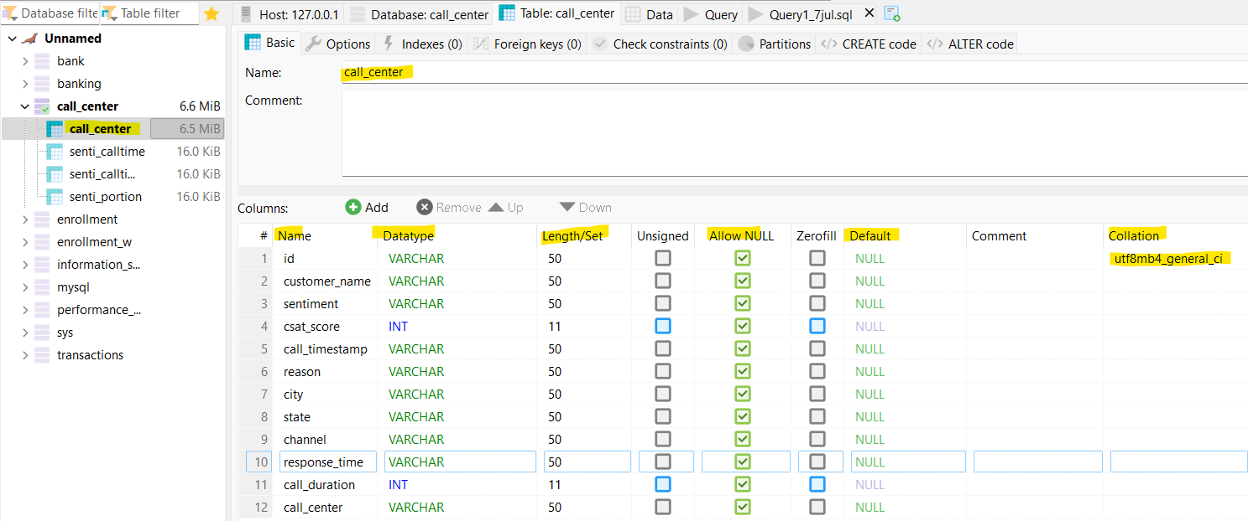
ETL step – Set up schema in HeidiSQL
Columns were filled with the necessary details shown:
Name: column name
Datatype: if it is string, use Varchar. If numerical, use Integer /Float (no decimal point so only Integer used)
Length: depending on the length of the string, numerical
Allow NULL: default all to allow null
Default: if no value given, to default as Null
Collation: default set to utf8mb4-general ci
*In “Collation”, the encoding type should be filled with utf8mb4-general ci for all columns.

Slide 5




Overview of strategies suggested
Infrastructure
Manpower Resourcing
Staff & Knowledge Management
Marketing
1) Set up FAQ for commonly asked questions online 2) Improve the infrastructure and data center 3) Improvement to database (include staff name) | 1) Manpower resourcing at specific call-centers, timings etc. 2) Focus call duration reduction efforts on target channel | 1) Encourage staff wellness 2) Implement staff incentive system 3) Quarterly central knowledge exchange session 4) Staff rotation for knowledge session and greater exposure | 1) Promotional events strategies

Slide 6

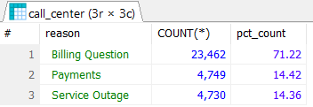
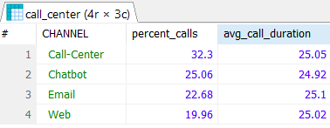
General analysis on queries
1
Billing qns comprises 71% of the total queries, followed by payments and service outage (equal split).
Recommend:
Set up a FAQ page online for common questions with greater focus on billing so customers can self-help
-> reduce the number of queries freeing up time for staff to do value-add tasks.
Highest percentage of contact are from call-center, and also had one of the highest average call duration.
Recommend:
1) Ensure enough staffing in this call-center channel since highest calls inflow and longest duration.
2) Focus call duration reduction efforts on call-center channel to reap the most impacts.

Slide 7
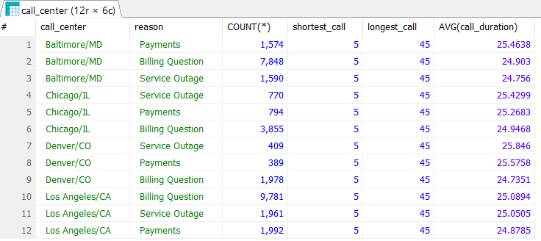
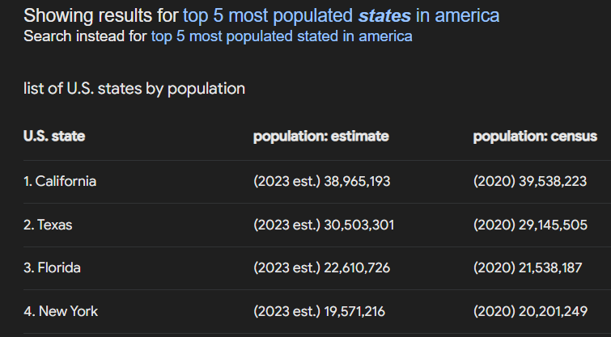
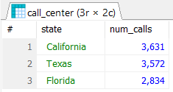

General analysis on queries
2
Average call duration is around 24-25 min, service outage taking up the longest call duration in 2 out of 4 states.
Recommend:
1) Having a similar average call duration of ~25 min across all call centers makes it easier to do resource planning. This will ensure a fairer workload for all staff across all 4 call centers resulting in happier staff
2) Set up redundancy and improve the infrastructure and data center to reduce service outage frequency.
Top 3 states with highest number of calls – California, Texas, Florida
Evaluation of result: Logical as # calls is proportional to the size of population in the US state.
Recommend: Promotional events strategies – physical events like roadshows, propose to hold it in these states for larger impact/awareness since more people are in the state (assumes people are willing to attend the event)

Slide 8
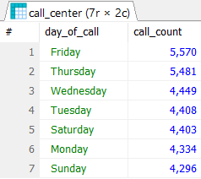
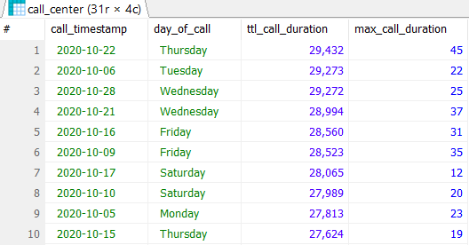

Temporal analysis
3
Highest no. of calls received on Fri
Recommend: Deploy more resources to handle high call traffic especially during off-work hours from 4-9pm as people may call in right after they knock off from work.
Tues - Thurs have longer overall call times.
Recommend: As each call will take up a longer time, encourage staff to take short breaks to relax their mind before serving next customer to ensure quality service rendered. Ensure staff retention by caring for their wellness while ensuring customers receive good service

Slide 9
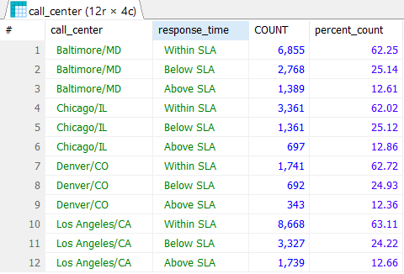
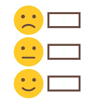
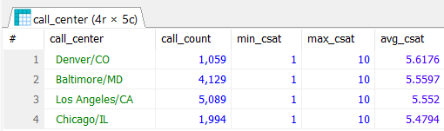
Service related analysis
4
LA has the highest percentage of calls within SLA
Assumption: Ideal response time is within SLA. If response time below SLA, customers may expect that their calls are picked up in equally fast speed in future hence best to manage their expectations by only answering the call within SLA period.
Recommend: Conduct a quarterly central knowledge exchange session for the call center staff. Best performing call center i.e. LA could share their best practices and learnings with other states to boost their performance.
CSAT (Customer satisfaction score) statistics – Denver has highest customer satisfaction, Chicago the least. Lack of trend/pattern observed between call count and customer satisfaction hence other factors like quality of service support from staff may be more critical in driving up customer satisfaction
Recommend: Improvement to database - Include name of staff servicing the customer in the database so we can perform correlation analysis to assess.

Slide 10
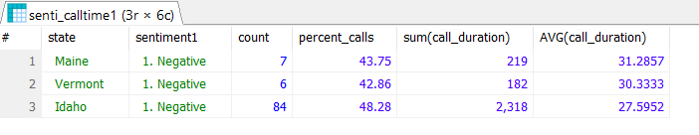
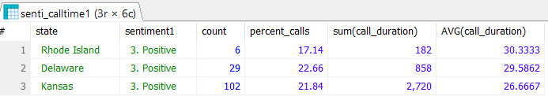
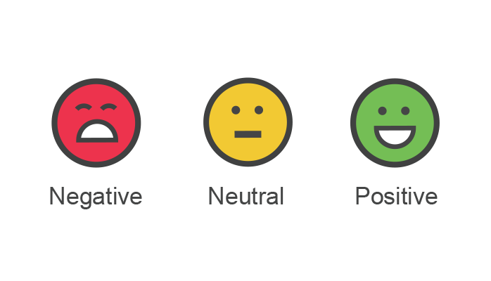
Sentiment analysis
5
Longest call durations with negative sentiment are generally from smaller countries like Maine, Vermont, Idaho. This could be because people there live at a slower pace or they have lots of query.
Recommend:
Deploy more experienced staff to help with long call times and improve customer sentiment.
Implement staff incentive system to encourage more staff to boost customer service support to improve sentiment.
Longest call durations with positive sentiment are from Delaware, Kansas
Recommend:
Schedule more staff to support the longer calls from these states to maintain positive sentiments.
Staff rotation from top performing states to lower performing states to share best practices and knowledge.

